Slide 1


Building the Autonomous Research Scientist: From Exploration Mechanisms to Scholarly Integrity
Yi R. (May) Fung
yrfung@ust.hk
Assistant Professor
Hong Kong University of Science and Technology
Jan 25, 2026
Notes:
My Abstract for https://ai4research-workshop.github.io/
The vision of an AI scientist, an agent that can autonomously discover, synthesize, and communicate new knowledge, is rapidly advancing beyond proof-of-concept. However, building such agents requires solving critical challenges at multiple stages of the research pipeline. In this talk, we will present a trilogy of works that address these core challenges. First, we will introduce Webwatcher, a vision-language deep research agent that breaks new frontiers by actively exploring and grounding its knowledge in real-world digital environments, moving beyond passive text analysis. Second, we will discuss our comprehensive survey, "Exploring Agentic MLLMs: A Survey for AIScientists", which provides the essential roadmap for AI scientists in terms of structuring the architectures and capabilities needed for such multimodal autonomous systems. Finally, I will address the cornerstone of scholarly trust: attribution. We will present CiteGuard, a novel framework for faithful citation validation that ensures the outputs of AI research agents are verifiable and credible. Together, these works form a cohesive vision for the next generation of AI4Research, where agents are not just tools for literature review, but active, trustworthy partners in the scientific process, capable of perception, synthesis, and rigorous scholarly communication.

Slide 2

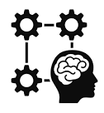




We’re Living in a Very Exciting Era of AI Advancements!
Growing Data
CoT Reasoning
Multi-Modal

Slide 3

“But what does the path to autonomous novel discovery with an AIScientist truly require? Exploration, with a visionary roadmap mapping, built on trust.”
Notes:
The path to discovery begins with exploration, is mapped by architecture, and is built on a foundation of trust.

Slide 4
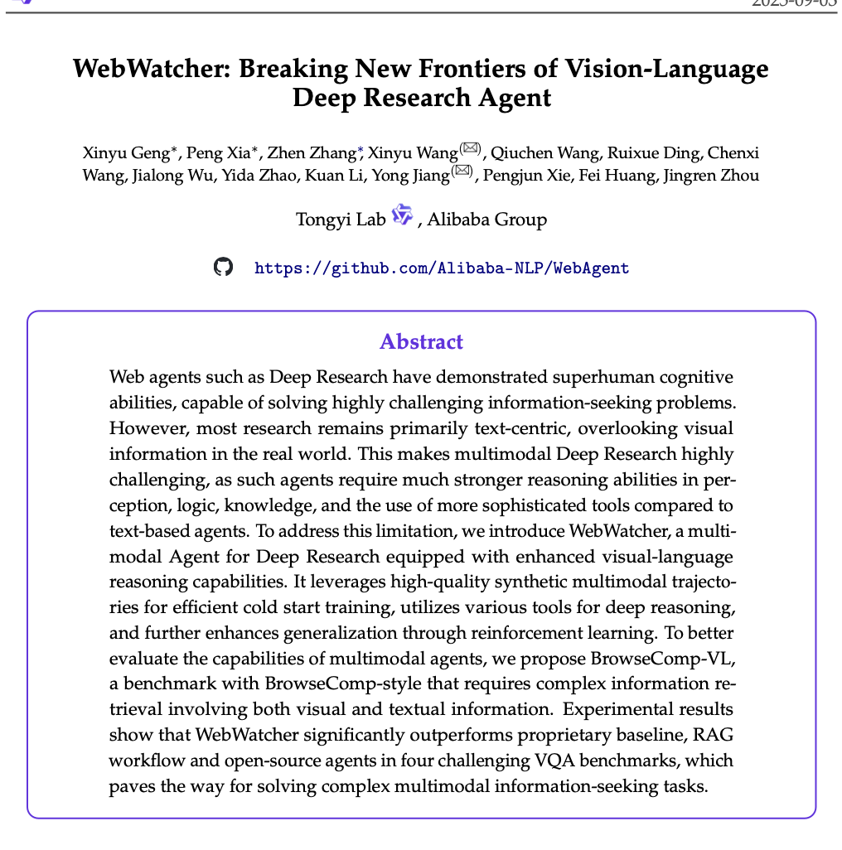
Crucial Gaps and Paths Forward for Autonomous AI Research Scientists
Deep Research Agentic Capability
Language
Vision
Validation

Slide 5
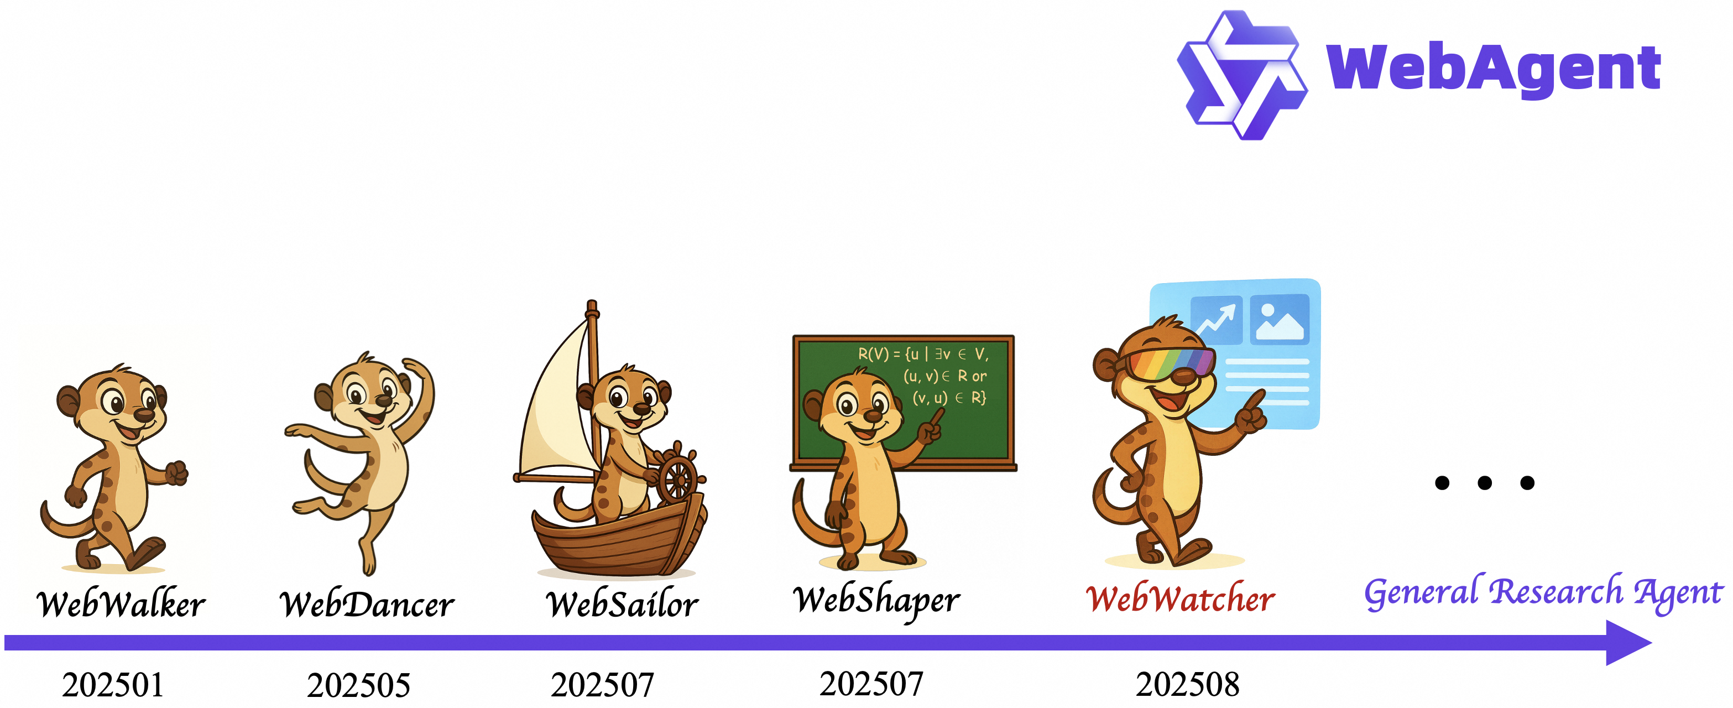
The Design of Retrieval-Augmented Web Agents

Slide 6
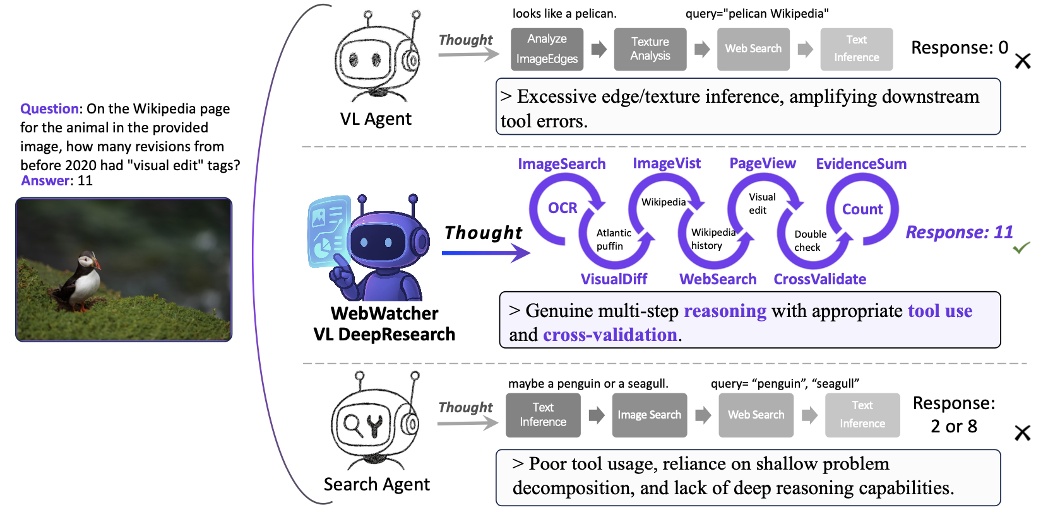
Comparison of Vision-Language Reasoning Agents
WebWatcher resolves the GAIA case that defeats either vision-only reasoning or search-based agents, demonstrating the strength of multi-tool integration and in-depth reasoning generalization.

Slide 7
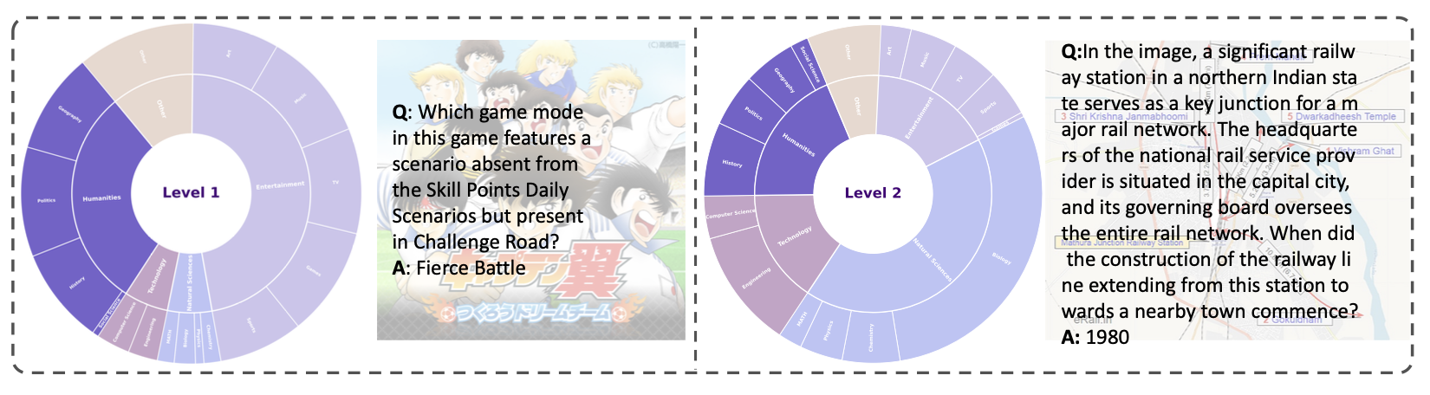
Domain Distribution of Our BrowseComp-VL Dataset
Organized into 5 major domains (e.g., entertainment, humanities, technology, natural science and other) and comprising 17 fine-grained subfields
Lvl 1: Questions require multi-hop reasoning but still reference explicit entities.
Lvl 2: Questions are constructed with intentionally obscured or fuzzified entities and attributes.

Slide 8
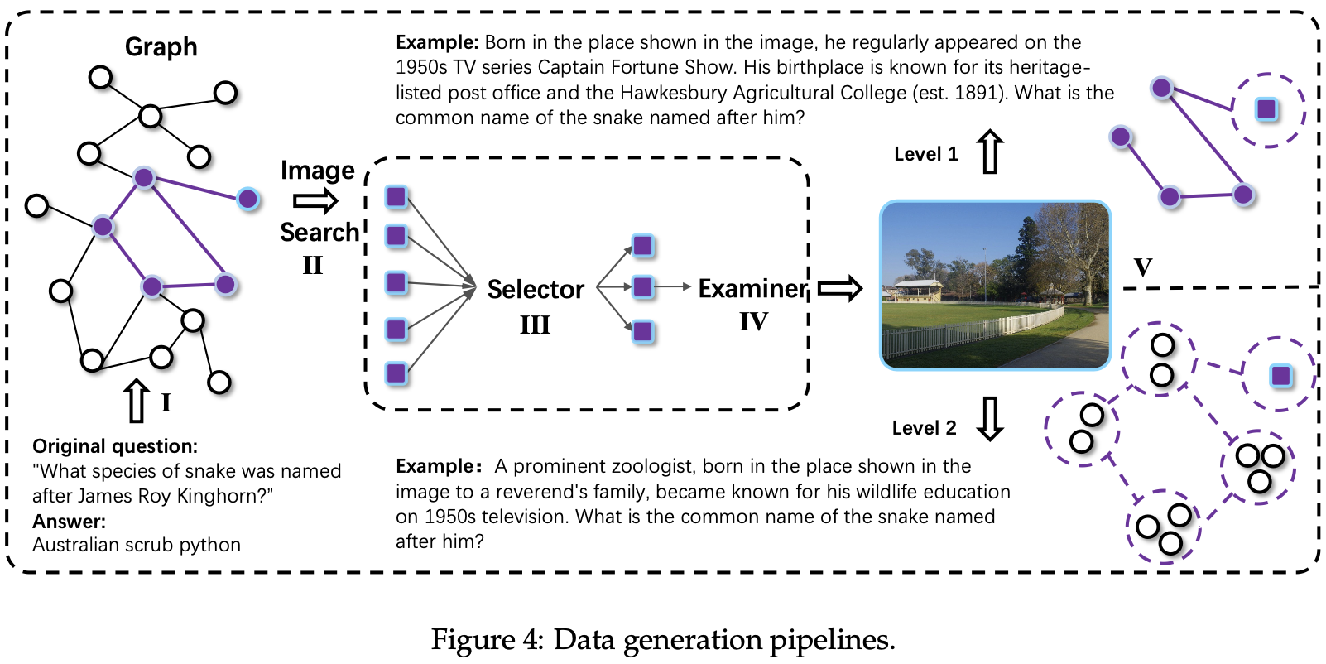
Data Generation Pipelines for WebWatcher

Slide 9
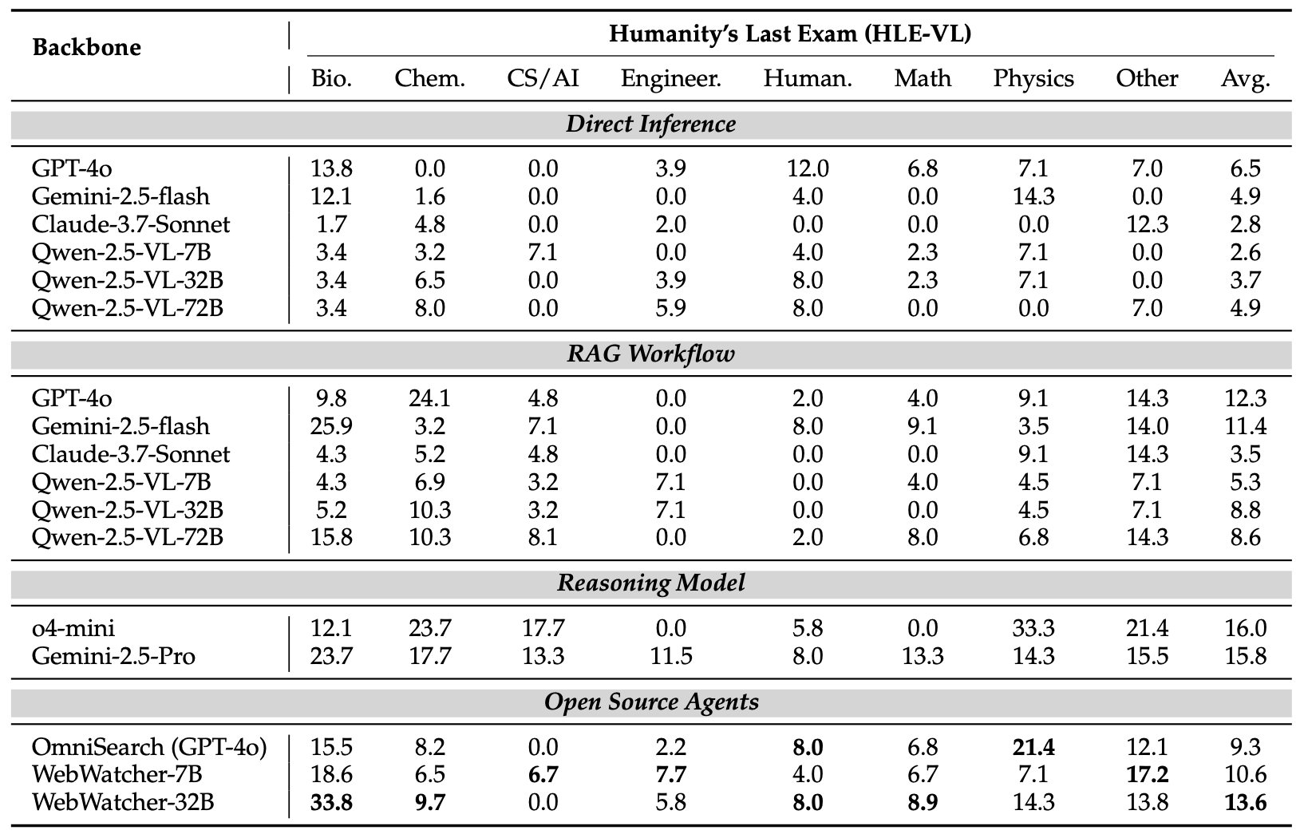
Empirical Performance of WebWatcher

Slide 10
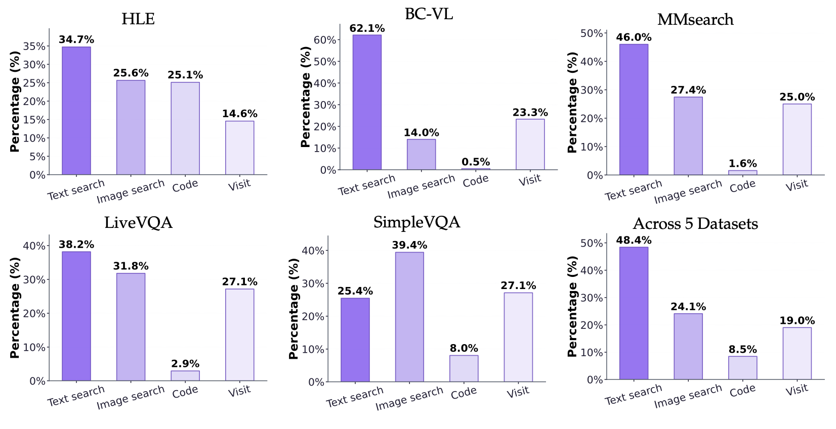
Distribution of Tool Calls by WebWatcher in VL Agent Benchmarks
Y-axis reflects fraction of total calls made to tool in x-axis

Slide 11
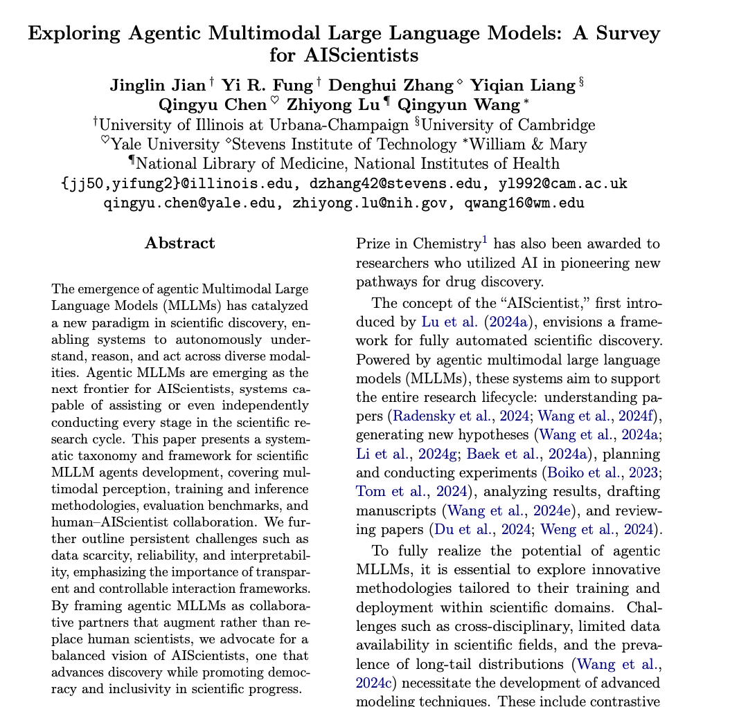
Crucial Gaps and Paths Forward for Autonomous AI Research Scientists
Deep Research Agentic Capability
Language
Vision
Validation

Slide 12
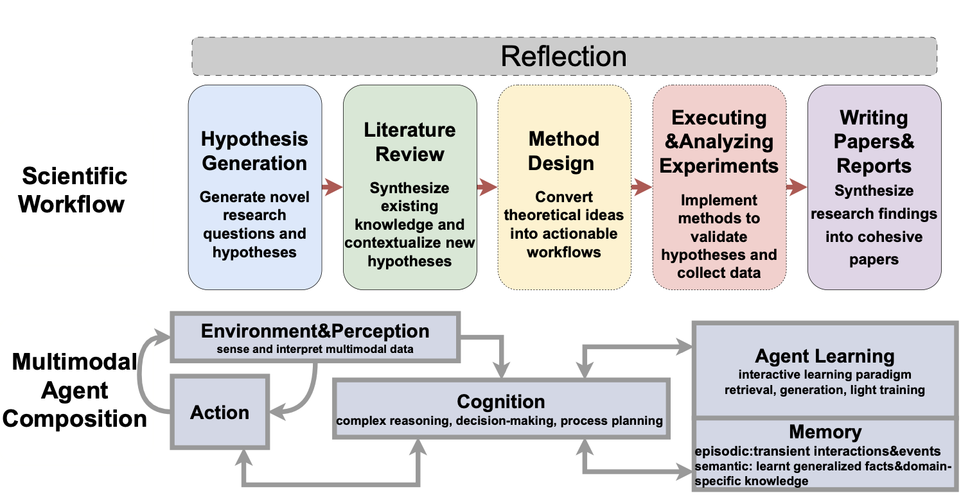
Preliminaries of the Modern Scientific Discovery Workflow
To support the end-to-end research lifecycle, agentic MLLMs employ a closed-loop system of Environment & Perception, Cognition, and Action, bolstered by Episodic and Semantic Memory for continuous learning.
This workflow drives the discovery process from Hypothesis Generation through Experiment Execution, utilizing an iterative Reflection layer to synthesize findings into cohesive reports and refine future research directions.

Slide 13
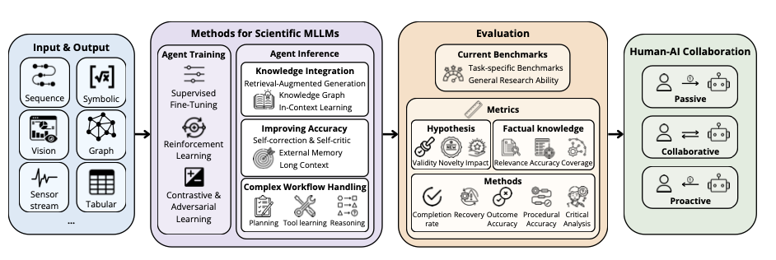
Overview of the Agentic MLLM Framework for Scientific Discovery
To handle the complexity of modern discovery, scientific MLLMs process diverse modalities including symbolic equations, molecular graphs, and sensor streams, utilizing specialized reinforcement and contrastive learning to manage the long-tail distributions inherent in scientific data.
High-fidelity results are further enabled through advanced workflow handling and knowledge integration, with success measured against robust metrics such as hypothesis novelty, impact, and procedural accuracy.

Slide 14
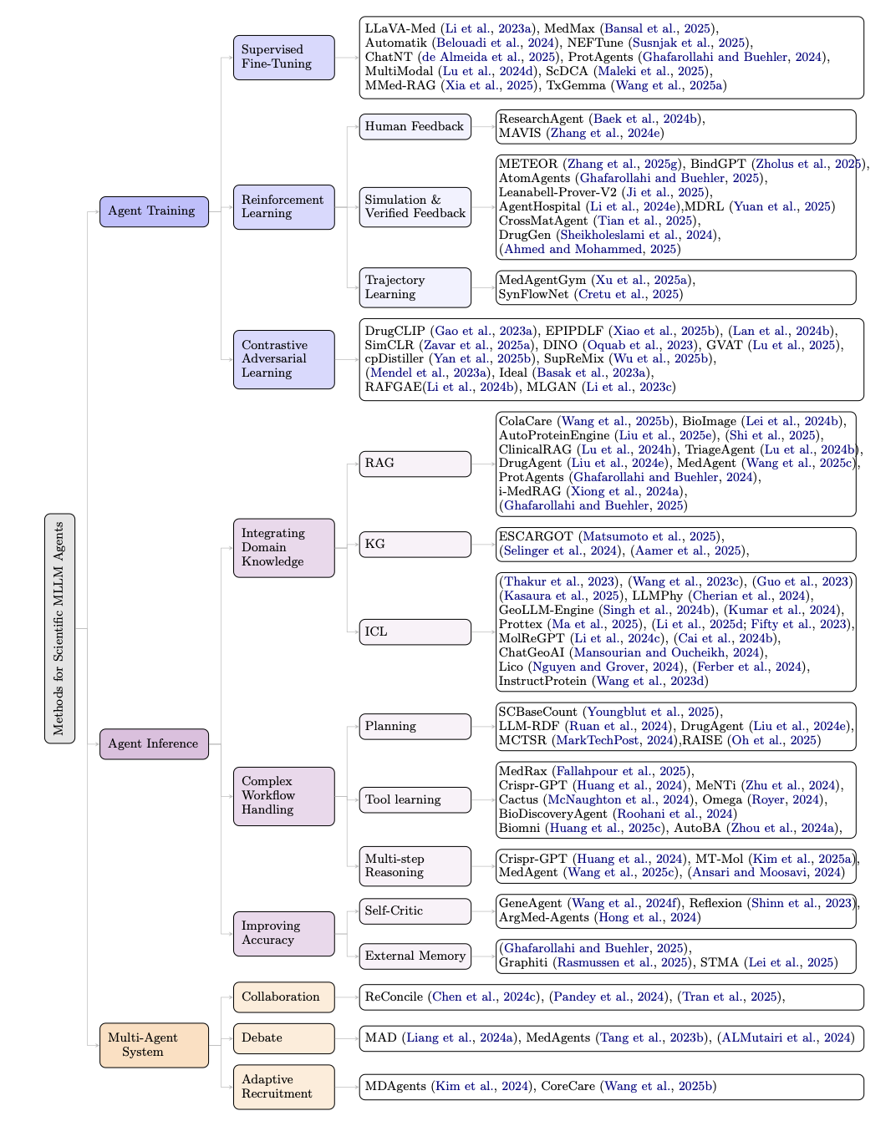
Taxonomy of Methods for Scientific MLLM Agents
Current SOTA methods (e.g., ProtAgents, MedAgent) utilize supervised finetuning training tailored for domain specific research.
To ground reasoning and enable autonomous discovery, agentic MLLMs integrate domain knowledge through techniques like RAG and In-Context Learning while leveraging specialized frameworks for complex reasoning and autonomous tool use.
Future-facing discovery utilizes multi-agent systems that employ debate (MAD), collaboration (ReConcile), and adaptive recruitment (MDAgents) to improve accuracy and reduce bias.

Slide 15
Ongoing Challenges and Future Directions
Addressing Data Scarcity: A primary hurdle remains the scarcity of high-quality multimodal scientific data and the prevalence of long-tail distributions that challenge standard model generalization.
Reliability and Interpretability: For AI to be a trusted partner, we must develop transparent and controllable interaction frameworks that allow human scientists to audit the AI's reasoning.
Human-AI Collaboration: The vision for AIScientists is a Collaborative Partner model, shifting from passive tools to proactive agents that augment, rather than replace, human expertise.
Democratizing Discovery: By reducing the technical barriers to complex experimentation, agentic MLLMs can promote inclusivity and democracy in the global scientific progress.
Jian, J., Fung, Y. R., Zhang, D., Liang, Y., Chen, Q., Lu, Z., & Wang, Q. (2025). Exploring Agentic Multimodal Large Language Models: A Survey for AIScientists. Authorea Preprints.

Slide 16
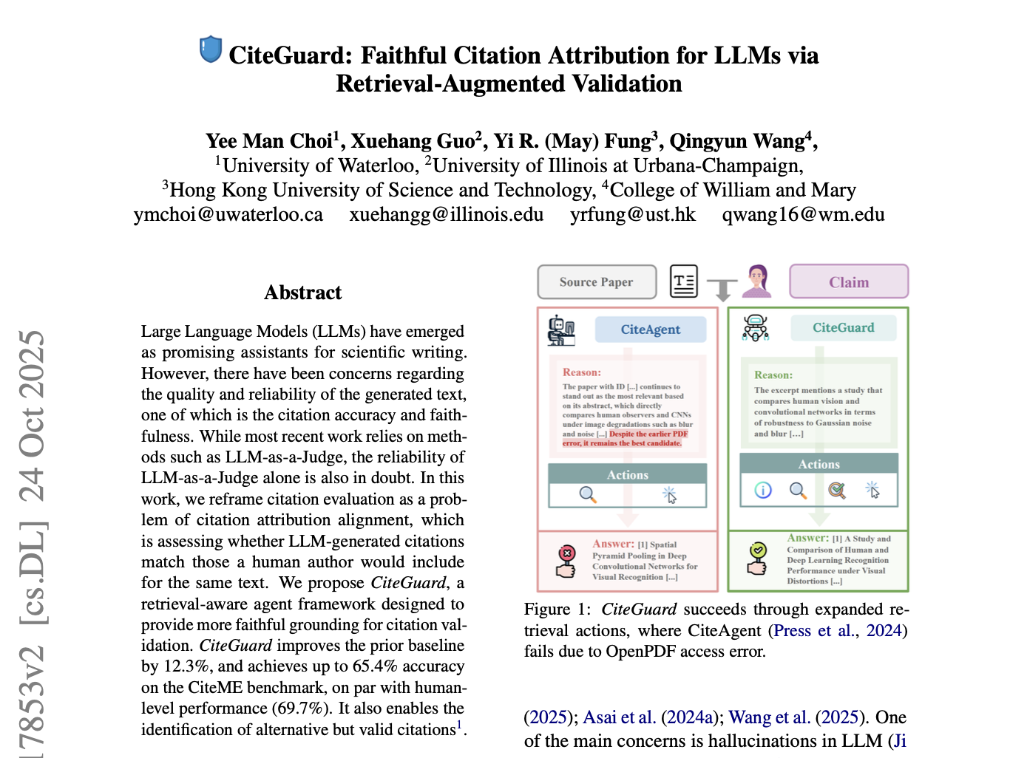
Crucial Gaps and Paths Forward for Autonomous AI Research Scientists
Deep Research Agentic Capability
Language
Vision
Validation

Slide 17

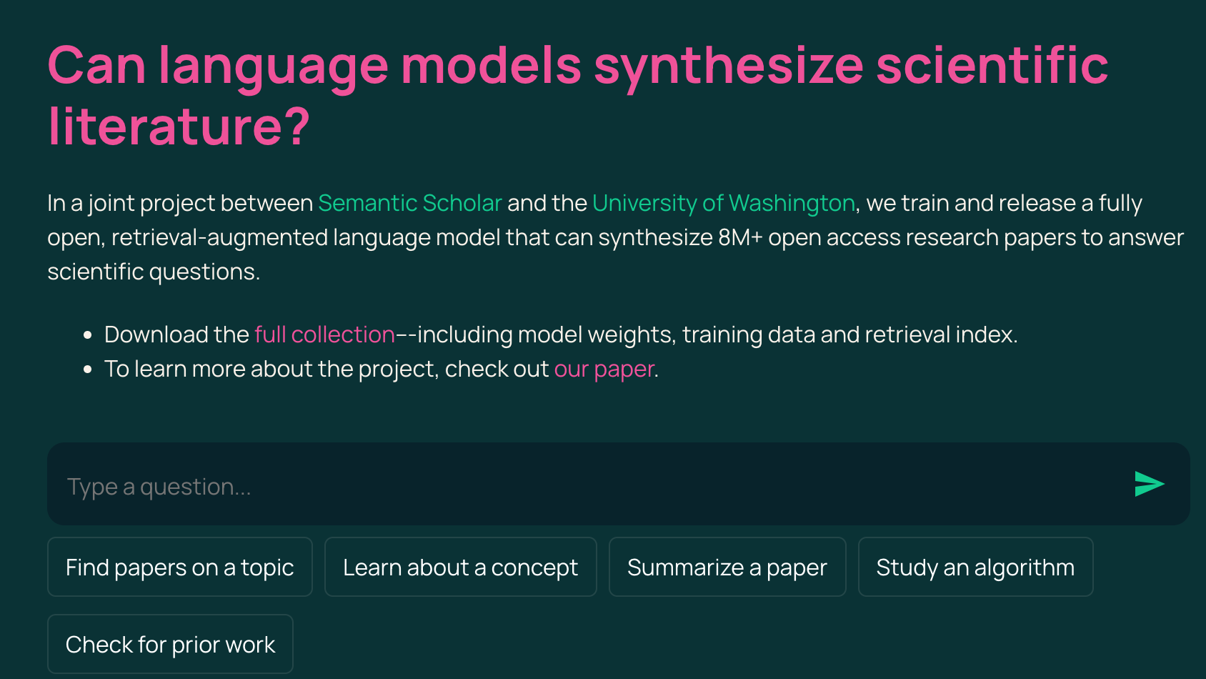
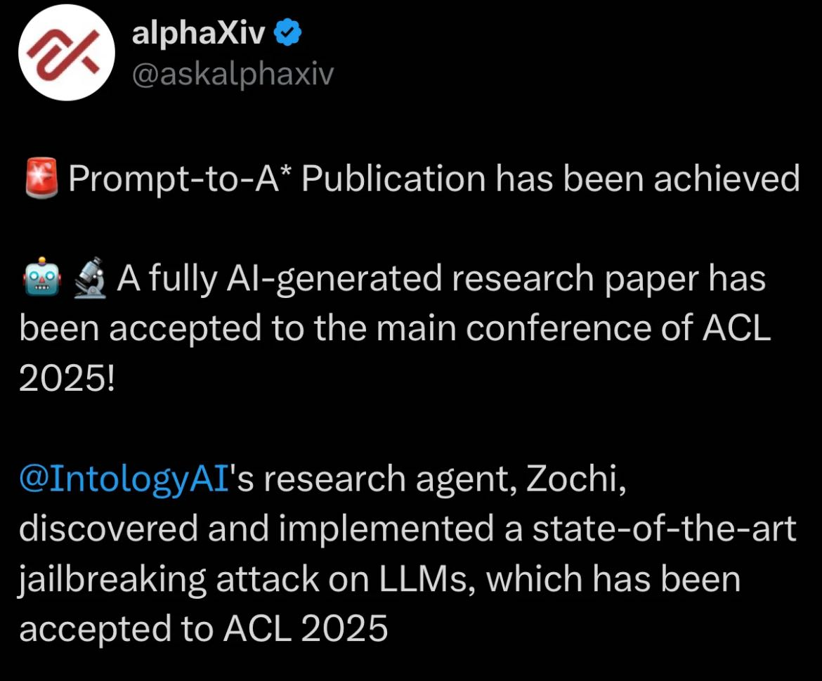
AI4Research

Slide 18
But there are still some concerns:
Let’s look at this from the scope of generated related work section:
How reliable is the generated text?
Is using LLM-as-a-Judge good enough?
Ye et.al, Justice or Prejudice? Quantifying Biases in LLM-as-a-Judge
How close is the generated text to human written ones?
Do we have comparative analysis like human would have? Or simply just a summary per paper in each sentence?
Li et.al, ChatCite: LLM Agent with Human Workflow Guidance for Comparative Literature Summary
Comparative Analysis Score (LLM-as-a-Judge)

Slide 19
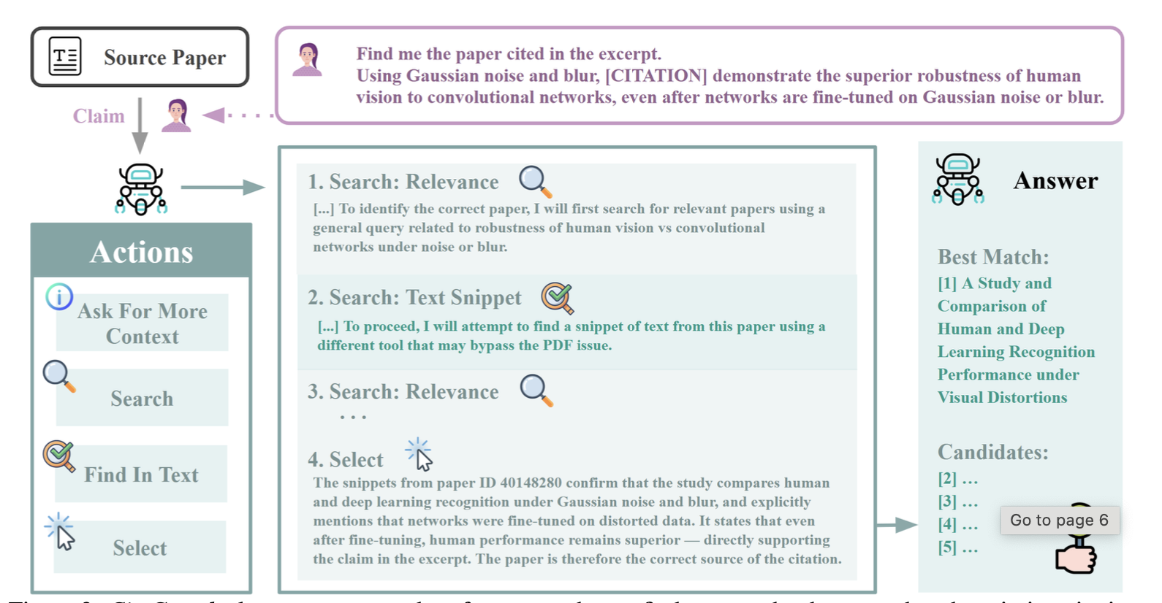
Our Proposed Framework, CiteGuard, Leverages Expanded Toolset for Agentic Validation of Scientific Text
Choi, Y. M., Guo, X., Fung, Y. R., & Wang, Q. (2025). CiteGuard: Faithful Citation Attribution for LLMs via Retrieval-Augmented Validation. arXiv preprint arXiv:2510.17853.

Slide 20
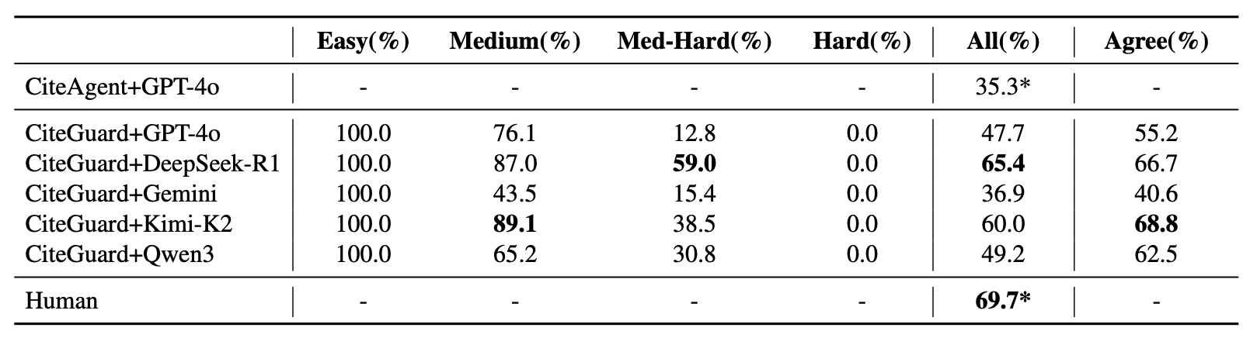
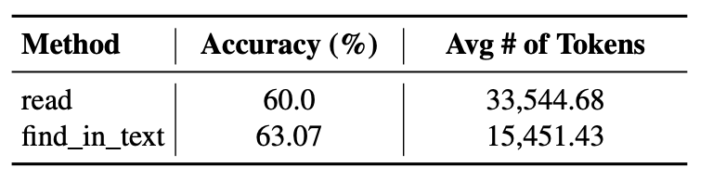
Experimental Results and Discussion
CiteGuard demonstrates that retrieval-augmented agents can achieve citation attribution fidelity on par with human authors (65.4% vs 69.7%).
🎊
Tool Efficiency Analysis in Precision vs. Cost: The find_in_text action is not only more accurate (63.07%) than the standard read action (60.0%) but also substantially more token-efficient, reducing consumption by over 50% (15k vs. 33k tokens).
Future Work: The consistent failure across all models on "Hard" samples (0.0%) suggests that complex, multi-hop reasoning for citation verification remains an open challenge for the next generation of autonomous research agents.

Slide 21
Summary of Key Takeaways
Today's proof-of-concepts are evolving into tomorrow's collaborators. This requires:
Eyes and Hands: Webwatcher provides active exploration beyond static text.
A Mind and Blueprint: Our survey for AIScientists structures the intelligence and capabilities needed.
A Voice of Trust: CiteGuard ensures this voice is credible and verifiable.
The future of autonomous discovery is collaborative, multimodal, and agentic in tool-enhanced interaction with the real-world environment.
Notes:
Quick recap Summary SLides

Slide 22




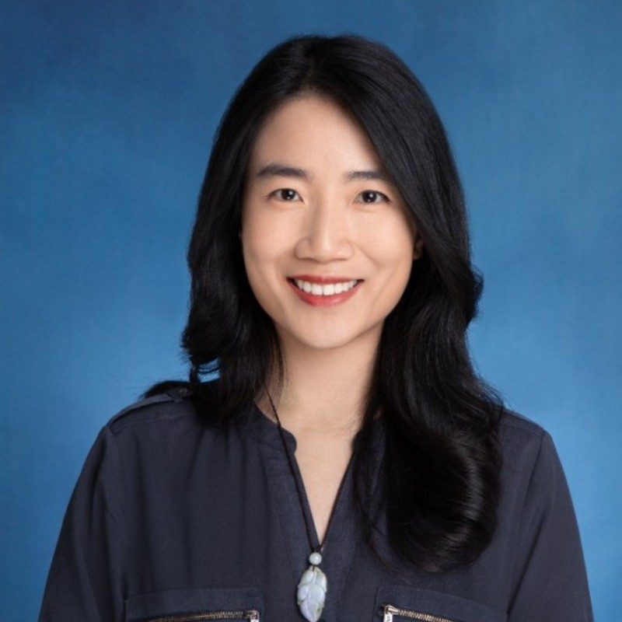
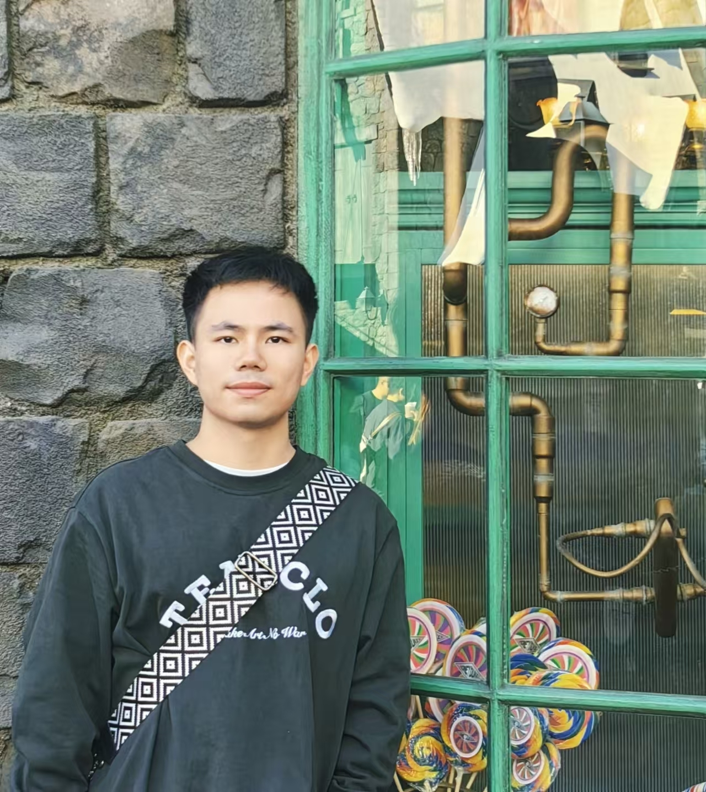
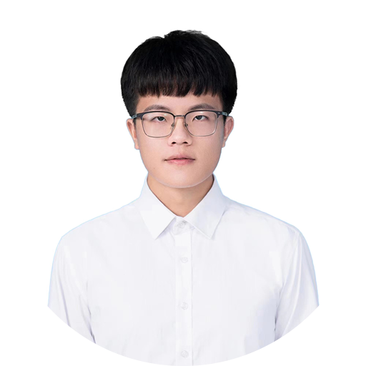
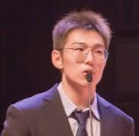
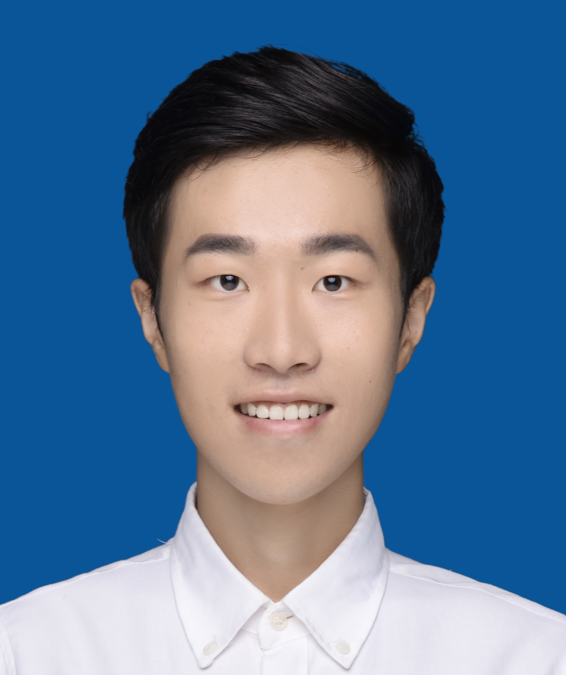

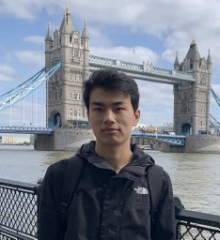
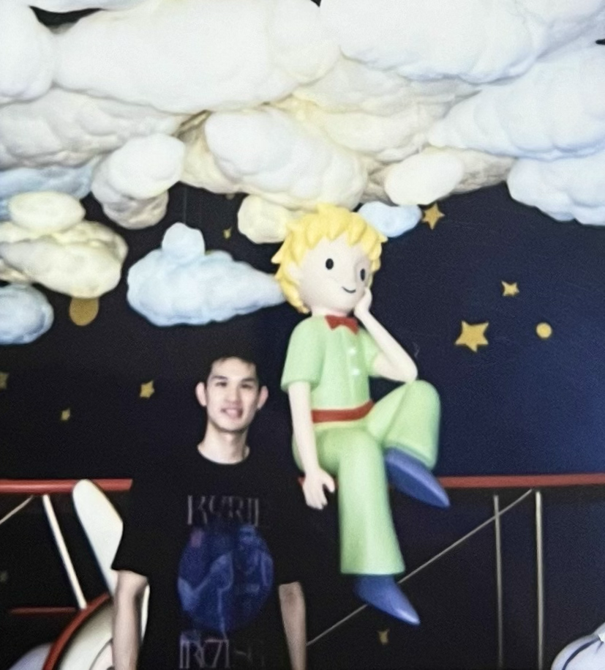
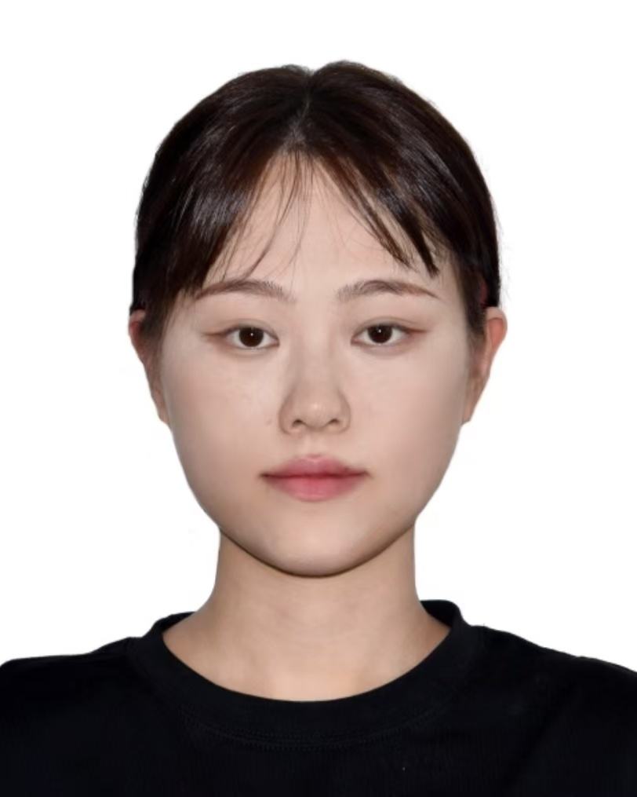
We are a Young and Energetic Team
Yi R. (May) Fung, PI
Zhitao He
Shijue Huang
Zhaochen Su
Zeyu Qin
https://mayrfung.github.io
Rui Min
Yuchen Huang
Xinyu Geng
Overarching Goal: Advance human-centered trustworthy AI with multimedia knowledge reasoning capability and scalable alignment principles for
helping solve real-world problems.
10

